Slide 1
Routing
An Engineering Approach to Computer Networking

Slide 2
What is it?
Process of finding a path from a source to every destination in the network
Suppose you want to connect to Antarctica from your desktop
  what route should you take?
  does a shorter route exist?
  what if a link along the route goes down?
  what if you’re on a mobile wireless link?
Routing deals with these types of issues

Slide 3
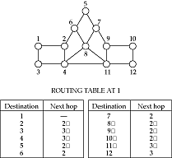
Basics
A routing protocol sets up a routing table in routers and switch controllers
A node makes a local choice depending on global topology: this is the fundamental problem

Slide 4
Key problem
How to make correct local decisions?
  each router must know something about global state
Global state
  inherently large
  dynamic
  hard to collect
A routing protocol must intelligently summarize relevant information

Slide 5
Requirements
Minimize routing table space
  fast to look up
  less to exchange
Minimize number and frequency of control messages
Robustness: avoid
  black holes
  loops
  oscillations
Use optimal path

Slide 6
Choices
Centralized vs. distributed routing
  centralized is simpler, but prone to failure and congestion
Source-based vs. hop-by-hop
  how much is in packet header?
  Intermediate: loose source route
Stochastic vs. deterministic
  stochastic spreads load, avoiding oscillations, but misorders
Single vs. multiple path
  primary and alternative paths (compare with stochastic)
State-dependent vs. state-independent
  do routes depend on current network state (e.g. delay)

Slide 7
Outline
Routing in telephone networks
Distance-vector routing
Link-state routing
Choosing link costs
Hierarchical routing
Internet routing protocols
Routing within a broadcast LAN
Multicast routing
Routing with policy constraints
Routing for mobile hosts

Slide 8
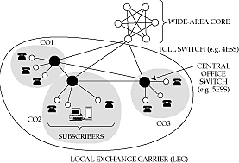
Telephone network topology
3-level hierarchy, with a fully-connected core
AT&T: 135 core switches with nearly 5 million circuits
LECs may connect to multiple cores

Slide 9
Routing algorithm
If endpoints are within same CO, directly connect
If call is between COs in same LEC, use one-hop path between COs
Otherwise send call to one of the cores
Only major decision is at toll switch
  one-hop or two-hop path to the destination toll switch
  (why don’t we need longer paths?)
Essence of problem
  which two-hop path to use if one-hop path is full

Slide 10
Features of telephone network routing
Stable load
  can predict pairwise load throughout the day
  can choose optimal routes in advance
Extremely reliable switches
  downtime is less than a few minutes per year
  can assume that a chosen route is available
  can’t do this in the Internet
Single organization controls entire core
  can collect global statistics and implement global changes
Very highly connected network
Connections require resources (but all need the same)

Slide 11
The cost of simplicity
Simplicity of routing a historical necessity
But requires
  reliability in every component
  logically fully-connected core
Can we build an alternative that has same features as the telephone network, but is cheaper because it uses more sophisticated routing?
  Yes: that is one of the motivations for ATM
  But 80% of the cost is in the local loop
    not affected by changes in core routing
  Moreover, many of the software systems assume topology
    too expensive to change them

Slide 12
Dynamic nonhierarchical routing (DNHR)
Simplest core routing protocol
  accept call if one-hop path is available, else drop
DNHR
  divides day into around 10-periods
  in each period, each toll switch is assigned a primary one-hop path and a list of alternatives
  can overflow to alternative if needed
  drop only if all alternate paths are busy
    crankback
Problems
  does not work well if actual traffic differs from prediction

Slide 13
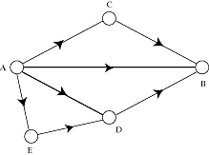
Metastability
Burst of activity can cause network to enter metastable state
  high blocking probability even with a low load
Removed by trunk reservation
  prevents spilled traffic from taking over direct path

Slide 14
Trunk status map routing (TSMR)
DNHR measures traffic once a week
TSMR updates measurements once an hour or so
  only if it changes “significantly”
List of alternative paths is more up to date

Slide 15
Real-time network routing (RTNR)
No centralized control
Each toll switch maintains a list of lightly loaded links
Intersection of source and destination lists gives set of lightly loaded paths
Example
  At A, list is C, D, E => links AC, AD, AE lightly loaded
  At B, list is D, F, G => links BD, BF, BG lightly loaded
  A asks B for its list
  Intersection = D => AD and BD lightly loaded => ADB lightly loaded => it is a good alternative path
Very effective in practice: only about a couple of calls blocked in core out of about 250 million calls attempted every day

Slide 16
Outline
Routing in telephone networks
Distance-vector routing
Link-state routing
Choosing link costs
Hierarchical routing
Internet routing protocols
Routing within a broadcast LAN
Multicast routing
Routing with policy constraints
Routing for mobile hosts

Slide 17
Distance vector routing
Environment
  links and routers unreliable
  alternative paths scarce
  traffic patterns can change rapidly
Two key algorithms
  distance vector
  link-state
Both assume router knows
  address of each neighbor
  cost of reaching each neighbor
Both allow a router to determine global routing information by talking to its neighbors

Slide 18
Basic idea
Node tells its neighbors its best idea of distance to every other node in the network
Node receives these distance vectors from its neighbors
Updates its notion of best path to each destination, and the next hop for this destination
Features
  distributed
  adapts to traffic changes and link failures
  suitable for networks with multiple administrative entities

Slide 19
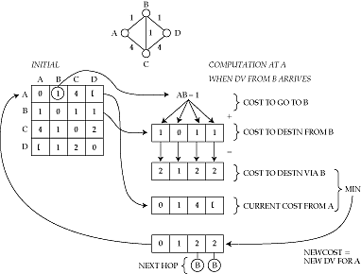
Example
2




Slide 20
Why does it work
Each node knows its true cost to its neighbors
This information is spread to its neighbors the first time it sends out its distance vector
Each subsequent dissemination spreads the truth one hop
Eventually, it is incorporated into routing table everywhere in the network
Proof: Bellman and Ford, 1957

Slide 21
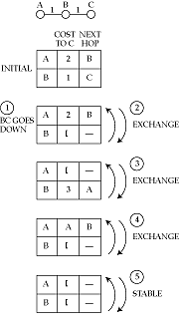
Problems with distance vector
Count to infinity

Slide 22
Dealing with the problem
Path vector
  DV carries path to reach each destination
Split horizon
  never tell neighbor cost to X if neighbor is next hop to X
  doesn’t work for 3-way count to infinity (see exercise)
Triggered updates
  exchange routes on change, instead of on timer
  faster count up to infinity
More complicated
  source tracing
  DUAL

Slide 23
Outline
Routing in telephone networks
Distance-vector routing
Link-state routing
Choosing link costs
Hierarchical routing
Internet routing protocols
Routing within a broadcast LAN
Multicast routing
Routing with policy constraints
Routing for mobile hosts

Slide 24
Link state routing
In distance vector, router knows only cost to each destination
  hides information, causing problems
In link state, router knows entire network topology, and computes shortest path by itself
  independent computation of routes
  potentially less robust
Key elements
  topology dissemination
  computing shortest routes

Slide 25
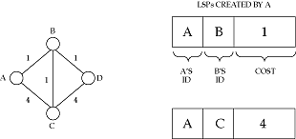
Link state: topology dissemination
A router describes its neighbors with a link state packet (LSP)
Use controlled flooding to distribute this everywhere
  store an LSP in an LSP database
  if new, forward to every interface other than incoming one
  a network with E edges will copy at most 2E times

Slide 26
Sequence numbers
How do we know an LSP is new?
Use a sequence number in LSP header
Greater sequence number is newer
What if sequence number wraps around?
  smaller sequence number is now newer!
  (hint: use a large sequence space)
On boot up, what should be the initial sequence number?
  have to somehow purge old LSPs
  two solutions
    aging
    lollipop sequence space

Slide 27
Aging
Creator of LSP puts timeout value in the header
Router removes LSP when it times out
  also floods this information to the rest of the network (why?)
So, on booting, router just has to wait for its old LSPs to be purged
But what age to choose?
  if too small
    purged before fully flooded (why?)
    needs frequent updates
  if too large
    router waits idle for a long time on rebooting

Slide 28
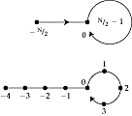
A better solution
Need a unique start sequence number
a is older than b if:
  a < 0 and a < b
  a > o, a < b, and b-a < N/4
  a > 0, b > 0, a > b, and a-b > N/4

Slide 29
More on lollipops
If a router gets an older LSP, it tells the sender about the newer LSP
So, newly booted router quickly finds out its most recent sequence number
It jumps to one more than that
-N/2 is a trigger to evoke a response from community memory

Slide 30
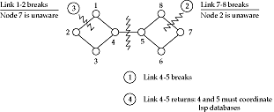
Recovering from a partition
On partition, LSP databases can get out of synch
Databases described by database descriptor records
Routers on each side of a newly restored link talk to each other to update databases (determine missing and out-of-date LSPs)

Slide 31
Router failure
How to detect?
  HELLO protocol
HELLO packet may be corrupted
  so age anyway
  on a timeout, flood the information

Slide 32
Securing LSP databases
LSP databases must be consistent to avoid routing loops
Malicious agent may inject spurious LSPs
Routers must actively protect their databases
  checksum LSPs
  ack LSP exchanges
  passwords

Slide 33
Computing shortest paths
Basic idea
  maintain a set of nodes P to whom we know shortest path
  consider every node one hop away from nodes in P = T
  find every way in which to reach a given node in T, and choose shortest one
  then add this node to P

Slide 34
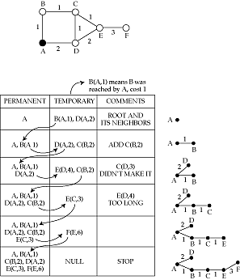
Example

Slide 35
Link state vs. distance vector
Criteria
  stability
  multiple routing metrics
  convergence time after a change
  communication overhead
  memory overhead
Both are evenly matched
Both widely used

Slide 36
Outline
Routing in telephone networks
Distance-vector routing
Link-state routing
Choosing link costs
Hierarchical routing
Internet routing protocols
Routing within a broadcast LAN
Multicast routing
Routing with policy constraints
Routing for mobile hosts

Slide 37
Choosing link costs
Shortest path uses link costs
Can use either static of dynamic costs
In both cases: cost determine amount of traffic on the link
  lower the cost, more the expected traffic
  if dynamic cost depends on load, can have oscillations (why?)

Slide 38

Static metrics
Simplest: set all link costs to 1 => min hop routing
  but 28.8 modem link is not the same as a T3!
Give links weight proportional to capacity

Slide 39
Dynamic metrics
A first cut (ARPAnet original)
Cost proportional to length of router queue
  independent of link capacity
Many problems when network is loaded
  queue length averaged over a small time => transient spikes caused major rerouting
  wide dynamic range => network completely ignored paths with high costs
  queue length assumed to predict future loads => opposite is true (why?)
  no restriction on successively reported costs => oscillations
  all tables computed simultaneously => low cost link flooded

Slide 40
Modified metrics
  queue length averaged over a small time
  wide dynamic range queue
  queue length assumed to predict future loads
  no restriction on successively reported costs
  all tables computed simultaneously
  queue length averaged over a longer time
  dynamic range restricted
  cost also depends on intrinsic link capacity
  restriction on successively reported costs
  attempt to stagger table computation

Slide 41
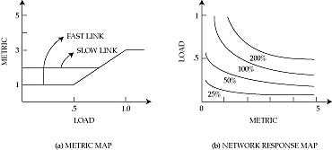
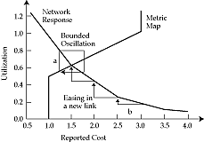
Routing dynamics

Slide 42
Outline
Routing in telephone networks
Distance-vector routing
Link-state routing
Choosing link costs
Hierarchical routing
Internet routing protocols
Routing within a broadcast LAN
Multicast routing
Routing with policy constraints
Routing for mobile hosts

Slide 43
Hierarchical routing
Large networks need large routing tables
  more computation to find shortest paths
  more bandwidth wasted on exchanging DVs and LSPs
Solution:
  hierarchical routing
Key idea
  divide network into a set of domains
  gateways connect domains
  computers within domain unaware of outside computers
  gateways know only about other gateways

Slide 44
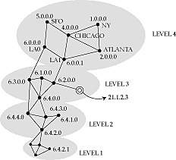
Example
Features
  only a few routers in each level
  not a strict hierarchy
  gateways participate in multiple routing protocols
  non-aggregable routers increase core table space

Slide 45
Hierarchy in the Internet
Three-level hierarchy in addresses
  network number
  subnet number
  host number
Core advertises routes only to networks, not to subnets
  e.g. 135.104.*, 192.20.225.*
Even so, about 80,000 networks in core routers (1996)
Gateways talk to backbone to find best next-hop to every other network in the Internet

Slide 46
External and summary records
If a domain has multiple gateways
  external records tell hosts in a domain which one to pick to reach a host in an external domain
    e.g allows 6.4.0.0 to discover shortest path to 5.* is through 6.0.0.0
  summary records tell backbone which gateway to use to reach an internal node
    e.g. allows 5.0.0.0 to discover shortest path to 6.4.0.0 is through 6.0.0.0
External and summary records contain distance from gateway to external or internal node
  unifies distance vector and link state algorithms

Slide 47
Interior and exterior protocols
Internet has three levels of routing
  highest is at backbone level, connecting autonomous systems (AS)
  next level is within AS
  lowest is within a LAN
Protocol between AS gateways: exterior gateway protocol
Protocol within AS: interior gateway protocol

Slide 48
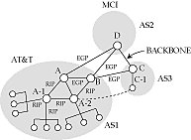
Exterior gateway protocol
Between untrusted routers
  mutually suspicious
Must tell a border gateway who can be trusted and what paths are allowed
Transit over backdoors is a problem

Slide 49
Interior protocols
Much easier to implement
Typically partition an AS into areas
Exterior and summary records used between areas

Slide 50
Issues in interconnection
May use different schemes (DV vs. LS)
Cost metrics may differ
Need to:
  convert from one scheme to another (how?)
  use the lowest common denominator for costs
  manually intervene if necessary

Slide 51
Outline
Routing in telephone networks
Distance-vector routing
Link-state routing
Choosing link costs
Hierarchical routing
Internet routing protocols
Routing within a broadcast LAN
Multicast routing
Routing with policy constraints
Routing for mobile hosts

Slide 52
Common routing protocols
Interior
  RIP
  OSPF
Exterior
  EGP
  BGP
ATM
  PNNI

Slide 53
RIP
Distance vector
Cost metric is hop count
Infinity = 16
Exchange distance vectors every 30 s
Split horizon
Useful for small subnets
  easy to install

Slide 54
OSPF
Link-state
Uses areas to route packets hierarchically within AS
Complex
  LSP databases to be protected
Uses designated routers to reduce number of endpoints

Slide 55
EGP
Original exterior gateway protocol
Distance-vector
Costs are either 128 (reachable) or 255 (unreachable) => reachability protocol => backbone must be loop free (why?)
Allows administrators to pick neighbors to peer with
Allows backdoors (by setting backdoor cost < 128)

Slide 56
BGP
Path-vector
  distance vector annotated with entire path
  also with policy attributes
  guaranteed loop-free
Can use non-tree backbone topologies
Uses TCP to disseminate DVs
  reliable
  but subject to TCP flow control
Policies are complex to set up

Slide 57
PNNI
Link-state
Many levels of hierarchy
Switch controllers at each level form a peer group
Group has a group leader
Leaders are members of the next higher level group
Leaders summarize information about group to tell higher level peers
All records received by leader are flooded to lower level
LSPs can be annotated with per-link QoS metrics
Switch controller uses this to compute source routes for call-setup packets

Slide 58
Outline
Routing in telephone networks
Distance-vector routing
Link-state routing
Choosing link costs
Hierarchical routing
Internet routing protocols
Routing within a broadcast LAN
Multicast routing
Routing with policy constraints
Routing for mobile hosts

Slide 59

Routing within a broadcast LAN
What happens at an endpoint?
On a point-to-point link, no problem
On a broadcast LAN
  is packet meant for destination within the LAN?
  if so, what is the datalink address ?
  if not, which router on the LAN to pick?
  what is the router’s datalink address?

Slide 60
Internet solution
All hosts on the LAN have the same subnet address
So, easy to determine if destination is on the same LAN
Destination’s datalink address determined using ARP
  broadcast a request
  owner of IP address replies
To discover routers
  routers periodically sends router advertisements
    with preference level and time to live
  pick most preferred router
  delete overage records
  can also force routers to reply with solicitation message

Slide 61
Redirection
How to pick the best router?
Send message to arbitrary router
If that router’s next hop is another router on the same LAN, host gets a redirect message
It uses this for subsequent messages

Slide 62
Outline
Routing in telephone networks
Distance-vector routing
Link-state routing
Choosing link costs
Hierarchical routing
Internet routing protocols
Routing within a broadcast LAN
Multicast routing
Routing with policy constraints
Routing for mobile hosts

Slide 63
Multicast routing
Unicast: single source sends to a single destination
Multicast: hosts are part of a multicast group
  packet sent by any member of a group are received by all
Useful for
  multiparty videoconference
  distance learning
  resource location

Slide 64
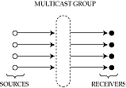
Multicast group
Associates a set of senders and receivers with each other
  but independent of them
  created either when a sender starts sending from a group
  or a receiver expresses interest in receiving
  even if no one else is there!
Sender does not need to know receivers’ identities
  rendezvous point

Slide 65
Addressing
Multicast group in the Internet has its own Class D address
  looks like a host address, but isn’t
Senders send to the address
Receivers anywhere in the world request packets from that address
“Magic” is in associating the two: dynamic directory service
Four problems
  which groups are currently active
  how to express interest in joining a group
  discovering the set of receivers in a group
  delivering data to members of a group

Slide 66
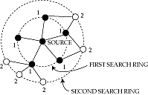
Expanding ring search
A way to use multicast groups for resource discovery
Routers decrement TTL when forwarding
Sender sets TTL and multicasts
  reaches all receivers <= TTL hops away
Discovers local resources first
Since heavily loaded servers can keep quiet, automatically distributes load

Slide 67
Multicast flavors
Unicast: point to point
Multicast:
  point to multipoint
  multipoint to multipoint
Can simulate point to multipoint by a set of point to point unicasts
Can simulate multipoint to multipoint by a set of point to multipoint multicasts
The difference is efficiency

Slide 68
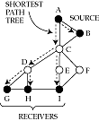
Example
Suppose A wants to talk to B, G, H, I, B to A, G, H, I
With unicast, 4 messages sent from each source
  links AC, BC carry a packet in triplicate
With point to multipoint multicast, 1 message sent from each source
  but requires establishment of two separate multicast groups
With multipoint to multipoint multicast, 1 message sent from each source,
  single multicast group

Slide 69
Shortest path tree
Ideally, want to send exactly one multicast packet per link
  forms a multicast tree rooted at sender
Optimal multicast tree provides shortest path from sender to every receiver
  shortest-path tree rooted at sender

Slide 70

Issues in wide-area multicast
Difficult because
  sources may join and leave dynamically
    need to dynamically update shortest-path tree
  leaves of tree are often members of broadcast LAN
    would like to exploit LAN broadcast capability
  would like a receiver to join or leave without explicitly notifying sender
    otherwise it will not scale

Slide 71
Multicast in a broadcast LAN
Wide area multicast can exploit a LAN’s broadcast capability
E.g. Ethernet will multicast all packets with multicast bit set on destination address
Two problems:
  what multicast MAC address corresponds to a given Class D IP address?
  does the LAN have contain any members for a given group (why do we need to know this?)

Slide 72
Class D to MAC translation
Multiple Class D addresses map to the same MAC address
Well-known translation algorithm => no need for a translation table
23 bits copied from IP address
01
00
5E
IEEE 802 MAC Address
Multicast bit
Reserved bit
Class D IP address
‘1110’ = Class D indication
Ignored

Slide 73
Internet Group Management Protocol
Detects if a LAN has any members for a particular group
  If no members, then we can prune the shortest path tree for that group by telling parent
Router periodically broadcasts a query message
Hosts reply with the list of groups they are interested in
To suppress traffic
  reply after random timeout
  broadcast reply
  if someone else has expressed interest in a group, drop out
To receive multicast packets:
  translate from class D to MAC and configure adapter

Slide 74
Wide area multicast
Assume
  each endpoint is a router
  a router can use IGMP to discover all the members in its LAN that want to subscribe to each multicast group
Goal
  distribute packets coming from any sender directed to a given group to all routers on the path to a group member

Slide 75
Simplest solution
Flood packets from a source to entire network
If a router has not seen a packet before, forward it to all interfaces except the incoming one
Pros
  simple
  always works!
Cons
  routers receive duplicate packets
  detecting that a packet is a duplicate requires storage, which can be expensive for long multicast sessions

Slide 76

A clever solution
Reverse path forwarding
Rule
  forward packet from S to all interfaces if and only if packet arrives on the interface that corresponds to the shortest path to S
  no need to remember past packets
  C need not forward packet received from D

Slide 77

Cleverer
Don’t send a packet downstream if you are not on the shortest path from the downstream router to the source
C need not forward packet from A to E
Potential confusion if downstream router has a choice of shortest paths to source (see figure on previous slide)

Slide 78
Pruning
RPF does not completely eliminate unnecessary transmissions
B and C get packets even though they do not need it
Pruning => router tells parent in tree to stop forwarding
Can be associated either with a multicast group or with a source and group
  trades selectivity for router memory

Slide 79
Rejoining
What if host on C’s LAN wants to receive messages from A after a previous prune by C?
  IGMP lets C know of host’s interest
  C can send a join(group, A) message to B, which propagates it to A
  or, periodically flood a message; C refrains from pruning

Slide 80

A problem
Reverse path forwarding requires a router to know shortest path to a source
  known from routing table
Doesn’t work if some routers do not support multicast
  virtual links between multicast-capable routers
  shortest path to A from E is not C, but F

Slide 81
A problem (contd.)
Two problems
  how to build virtual links
  how to construct routing table for a network with virtual links

Slide 82
Tunnels
Why do we need them?
Consider packet sent from A to F via multicast-incapable D
If packet’s destination is Class D, D drops it
If destination is F’s address, F doesn’t know multicast address!
So, put packet destination as F, but carry multicast address internally
Encapsulate IP in IP => set protocol type to IP-in-IP

Slide 83
Multicast routing protocol
Interface on “shortest path” to source depends on whether path is real or virtual
Shortest path from E to A is not through C, but F
  so packets from F will be flooded, but not from C
Need to discover shortest paths only taking multicast-capable routers into account
  DVMRP

Slide 84
DVMRP
Distance-vector Multicast routing protocol
Very similar to RIP
  distance vector
  hop count metric
Used in conjunction with
  flood-and-prune (to determine memberships)
    prunes store per-source and per-group information
  reverse-path forwarding (to decide where to forward a packet)
  explicit join messages to reduce join latency (but no source info, so still need flooding)

Slide 85
MOSPF
Multicast extension to OSPF
Routers flood group membership information with LSPs
Each router independently computes shortest-path tree that only includes multicast-capable routers
  no need to flood and prune
Complex
  interactions with external and summary records
  need storage per group per link
  need to compute shortest path tree per source and group

Slide 86
Core-based trees
Problems with DVMRP-oriented approach
  need to periodically flood and prune to determine group members
  need to source per-source and per-group prune records at each router
Key idea with core-based tree
  coordinate multicast with a core router
  host sends a join request to core router
  routers along path mark incoming interface for forwarding

Slide 87
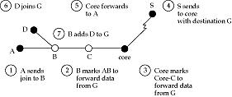
Example
Pros
  routers not part of a group are not involved in pruning
  explicit join/leave makes membership changes faster
  router needs to store only one record per group
Cons
  all multicast traffic traverses core, which is a bottleneck
  traffic travels on non-optimal paths

Slide 88
Protocol independent multicast (PIM)
Tries to bring together best aspects of CBT and DVMRP
Choose different strategies depending on whether multicast tree is dense or sparse
  flood and prune good for dense groups
    only need a few prunes
    CBT needs explicit join per source/group
  CBT good for sparse groups
Dense mode PIM == DVMRP
Sparse mode PIM is similar to CBT
  but receivers can switch from CBT to a shortest-path tree

Slide 89
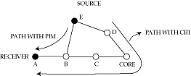
PIM (contd.)
In CBT, E must send to core
In PIM, B discovers shorter path to E (by looking at unicast routing table)
  sends join message directly to E
  sends prune message towards core
Core no longer bottleneck
Survives failure of core

Slide 90
More on core
Renamed a rendezvous point
  because it no longer carries all the traffic like a CBT core
Rendezvous points periodically send “I am alive” messages downstream
Leaf routers set timer on receipt
If timer goes off, send a join request to alternative rendezvous point
Problems
  how to decide whether to use dense or sparse mode?
  how to determine “best” rendezvous point?

Slide 91
Outline
Routing in telephone networks
Distance-vector routing
Link-state routing
Choosing link costs
Hierarchical routing
Internet routing protocols
Routing within a broadcast LAN
Multicast routing
Routing with policy constraints
Routing for mobile hosts

Slide 92
Routing vs. policy routing
In standard routing, a packet is forwarded on the ‘best’ path to destination
  choice depends on load and link status
With policy routing, routes are chosen depending on policy directives regarding things like
  source and destination address
  transit domains
  quality of service
  time of day
  charging and accounting
The general problem is still open
  fine balance between correctness and information hiding

Slide 93
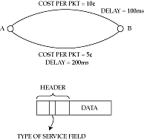
Multiple metrics
Simplest approach to policy routing
Advertise multiple costs per link
Routers construct multiple shortest path trees

Slide 94
Problems with multiple metrics
All routers must use the same rule in computing paths
Remote routers may misinterpret policy
  source routing may solve this
  but introduces other problems (what?)

Slide 95
Provider selection
Another simple approach
Assume that a single service provider provides almost all the path from source to destination
  e.g. AT&T or MCI
Then, choose policy simply by choosing provider
  this could be dynamic (agents!)
In Internet, can use a loose source route through service provider’s access point
Or, multiple addresses/names per host

Slide 96

Crankback
Consider computing routes with QoS guarantees
Router returns packet if no next hop with sufficient QoS can be found
In ATM networks (PNNI) used for the call-setup packet
In Internet, may need to be done for _every_ packet!
  Will it work?

Slide 97
Outline
Routing in telephone networks
Distance-vector routing
Link-state routing
Choosing link costs
Hierarchical routing
Internet routing protocols
Routing within a broadcast LAN
Multicast routing
Routing with policy constraints
Routing for mobile hosts

Slide 98
Mobile routing
How to find a mobile host?
Two sub-problems
  location (where is the host?)
  routing (how to get packets to it?)
We will study mobile routing in the Internet and in the telephone network

Slide 99
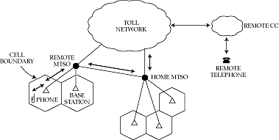
Mobile routing in the telephone network
Each cell phone has a global ID that it tells remote MTSO when turned on (using slotted ALOHA up channel)
Remote MTSO tells home MTSO
To phone: call forwarded to remote MTSO to closest base
From phone: call forwarded to home MTSO from closest base
New MTSOs can be added as load increases

Slide 100
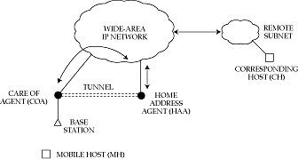
Mobile routing in the Internet
Very similar to mobile telephony
  but outgoing traffic does not go through home
  and need to use tunnels to forward data
Use registration packets instead of slotted ALOHA
  passed on to home address agent
Old care-of-agent forwards packets to new care-of-agent until home address agent learns of change

Slide 101
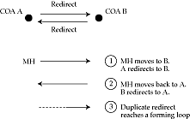
Problems
Security
  mobile and home address agent share a common secret
  checked before forwarding packets to COA
Loops

